Slide 1


Department of Computer Science and Engineering
Medical Report Analyser: A Machine System for Multi-format Medical Diagnosis and Visualization
Mrs. M. Divya M.E.
Asst.Professor ,
Dept of CSE,
Rajalakshmi Engineering College
220701212
Rahgul S

Slide 2
Problem Statement and Motivation
Medical reports today are often found in different formats like PDFs, CSVs, and scanned images, making it hard to analyze them in a single workflow. Manual interpretation is slow, error-prone, and highly dependent on the physician’s availability and accuracy. In rural clinics or overloaded environments, the lack of automation leads to delays and misdiagnoses. Our motivation is to create a smart, unified system that can read, interpret, and analyze these reports in real time and help support faster decision-making.

Slide 3
Existing System
Current systems are often restricted to structured data like EHRs or spreadsheets and cannot process scanned documents or PDFs. They also fail to provide visual analytics like condition probabilities or clinical risk levels. Moreover, many tools are disease-specific and not generalized across multiple conditions. There’s no unified pipeline that handles mixed-format data while also ensuring accuracy and explainability.

Slide 4
Objectives
Create a machine learning-based diagnosis system for diverse input types.
Enable OCR and PDF text extraction for unstructured formats.
Use a Random Forest model for accurate condition classification.
Provide clinical risk scores (heart, stroke, sepsis).
Generate interpretable visual outputs and doctor-style summaries.

Slide 5
Abstract
This project presents a smart diagnostic system named Medical Report Analyser.
It is capable of reading, processing, and interpreting clinical reports in various formats like CSV, PDFs, and scanned images. The system uses pytesseract and pdfplumber to extract medical parameters. Features are preprocessed and passed into a Random Forest model trained on 1000 synthetic records. The output includes the predicted condition, clinical risk scores, and a bar graph showing the top-5 possible diagnoses. Designed for real-time use, the analyser bridges the gap between structured and unstructured diagnostics and supports deployment in rural or overloaded clinical setups

Slide 6
Proposed System
The proposed system follows a modular architecture for robustness and clarity. It begins with detecting the input file type (CSV, image, or PDF). If unstructured, it invokes OCR to extract text. The extracted text is parsed using regular expressions to find values like glucose, WBC, and hemoglobin. These values are normalized and fed into a trained Random Forest classifier. The model predicts the disease and ranks top probable conditions. It then generates visual risk scores and recommendation text. All modules work together to provide an end-to-end diagnosis system with speed and accuracy.

Slide 7
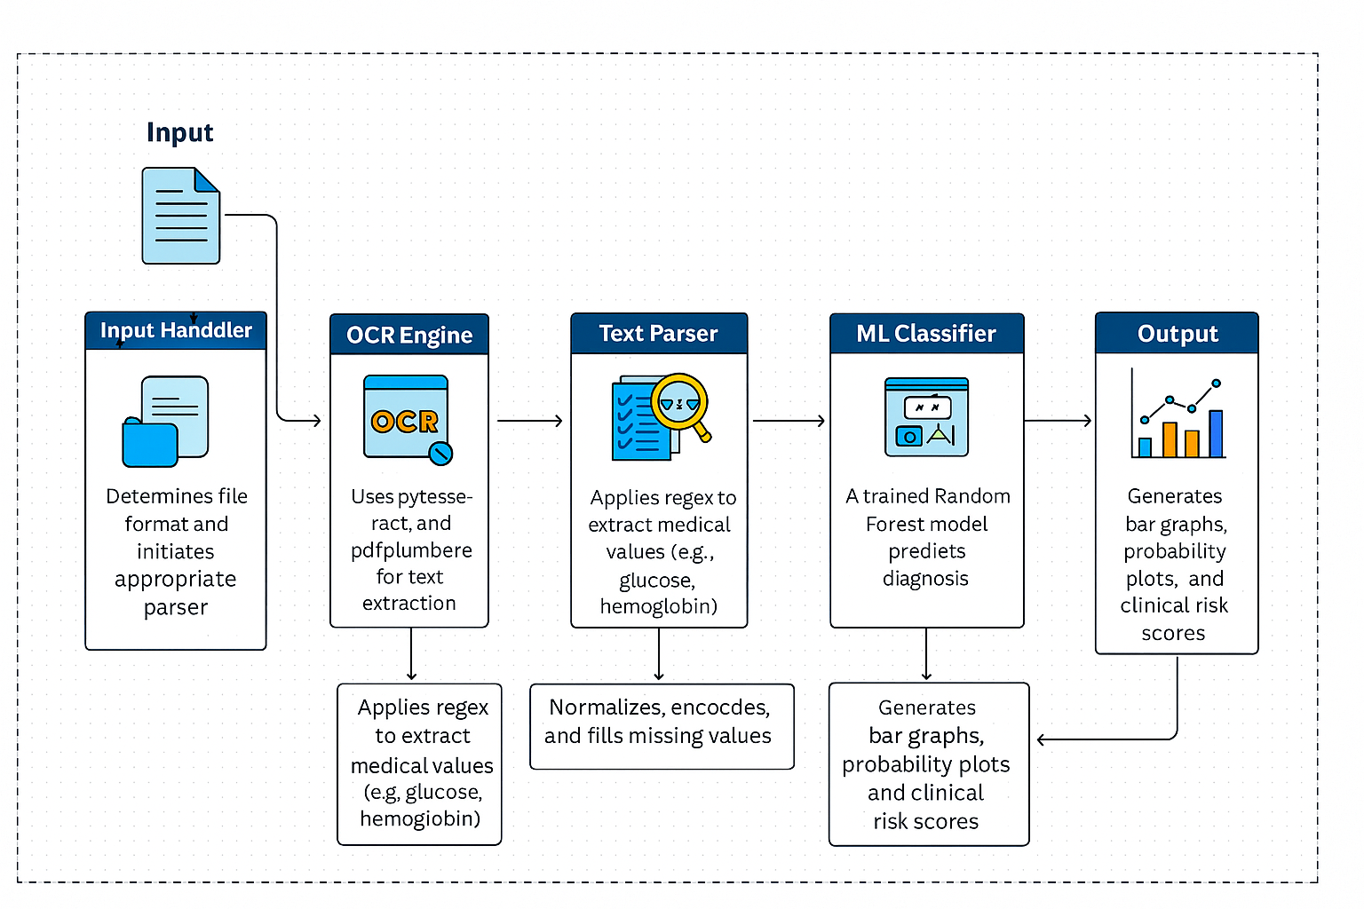
System Architecture
The system consists of six main modules: input handler, OCR engine, text parser, preprocessor, classifier, and visualizer.

Slide 8
List of Modules
The Input Module detects the report format.
The OCR Module processes scanned or image files.
The Parser extracts relevant health metrics using regular expressions.
The Preprocessor handles normalization and missing values.
The Classifier is a Random Forest model that predicts the disease
The Visualizer displays bar charts, risk scores, and generates doctor comments.

Slide 9
Functional Description for each modules with DFD and Activity Diagram
The Upload and Format Detection Module ensures flexibility in inputs.
The OCR and Text Extraction Module supports scanned PDFs and
handwritten reports.
The Feature Extraction Module transforms raw values into structured data.
The ML Engine provides diagnosis and confidence scores.
The Output Generator creates risk graphs and recommendation summaries.

Slide 10
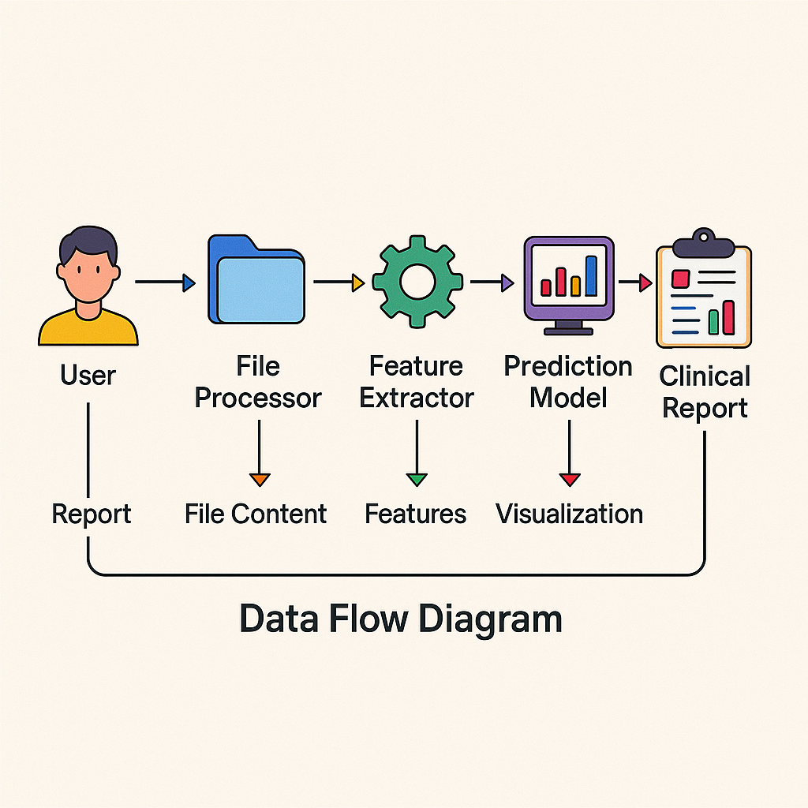
Functional Description for each modules with DFD and Activity Diagram

Slide 11
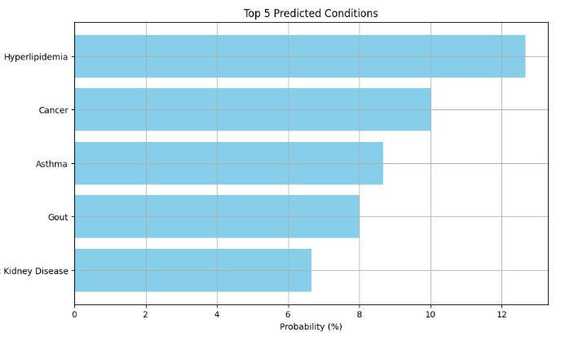
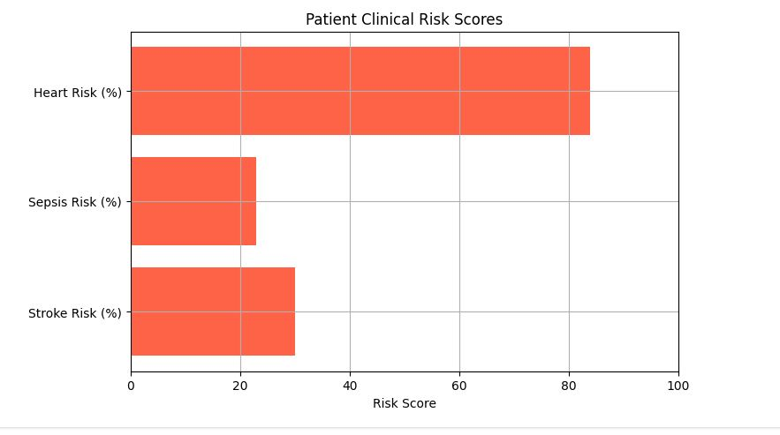
Implementation & Results of Module

Slide 12
Conclusion & Future Work
We developed a unified machine learning system to analyze medical reports across formats. The system was validated with strong performance metrics and produces visually interpretable output. It supports OCR and PDF parsing, feature extraction, and classification in one integrated pipeline. In the future, we plan to add blockchain for secure record storage. We'll also expand the model to use real hospital EHR data and support multilingual inputs. The interface can be deployed as a web app or mobile tool. Overall, the system reduces diagnostic delays, improves accuracy, and supports real-world clinical integration.

Slide 13
References
[1] Kumar P. et al., “LangChain-Based Cardiovascular Disease Predictor,” Proc. IEEE Conf. HealthAI, 10601906, 2024.
[2] Alhudhaif A. et al., “Soft-Attention CNN with Random Forests for Skin Detection,” Chaos, Solitons & Fractals, vol. 167, 113409, 2023.
[3] Sadik R. et al., “Transfer Learning in CNNs for Skin Disease Classification,” Health Informatics Journal, vol. 29, no. 2, 100143, 2023.

Slide 14
Thank You

